Slide 1
ACCY577 Machine Learning for Accounting
Module 2: Fundamental Algorithms I
Linden Lu

Slide 2
Lesson 1: Linear Regression
Supervised Learning
Predict continuous output
Assume linear relationships between input and output
Feature scaling is normally not needed

Slide 3
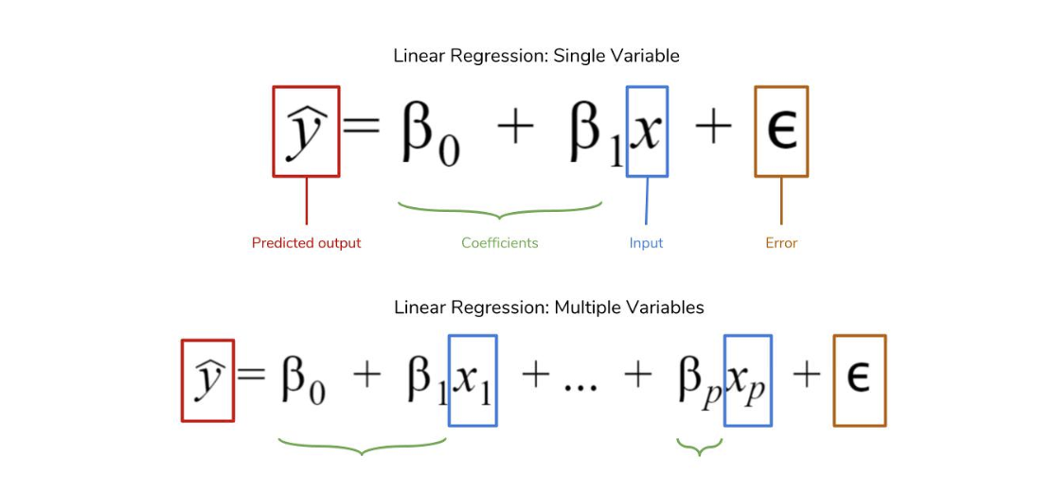
Linear Regression

Slide 4
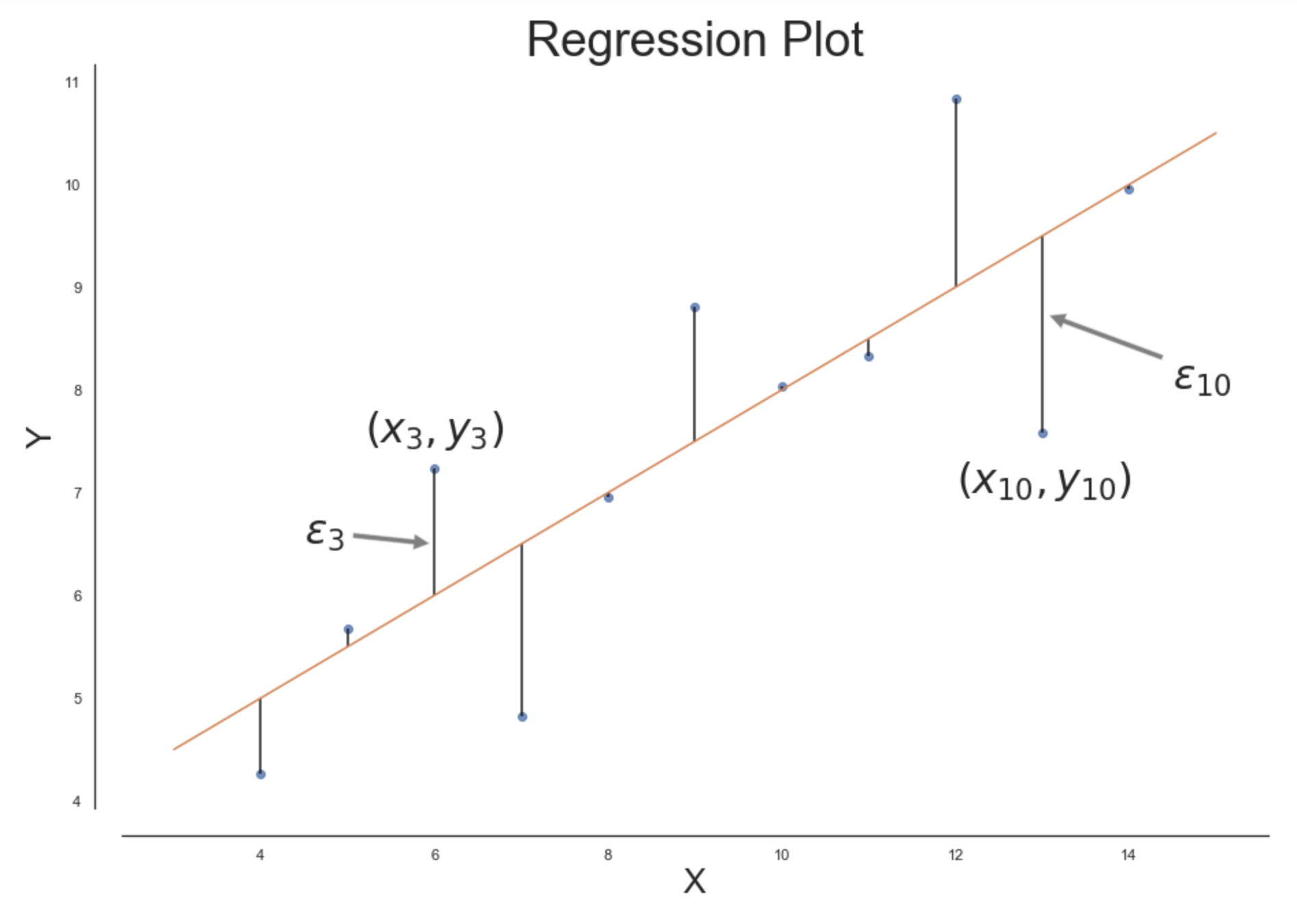
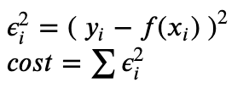
Cost Function

Slide 5
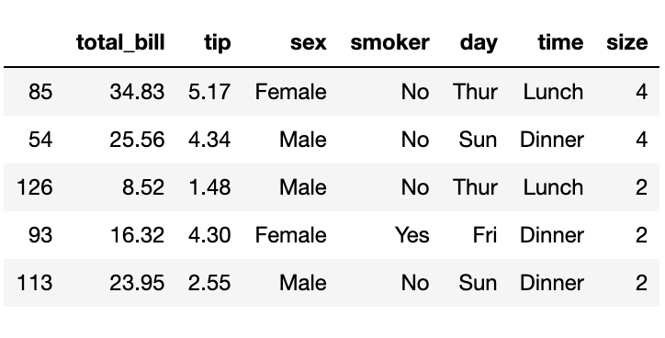
Tips Dataset

Slide 6
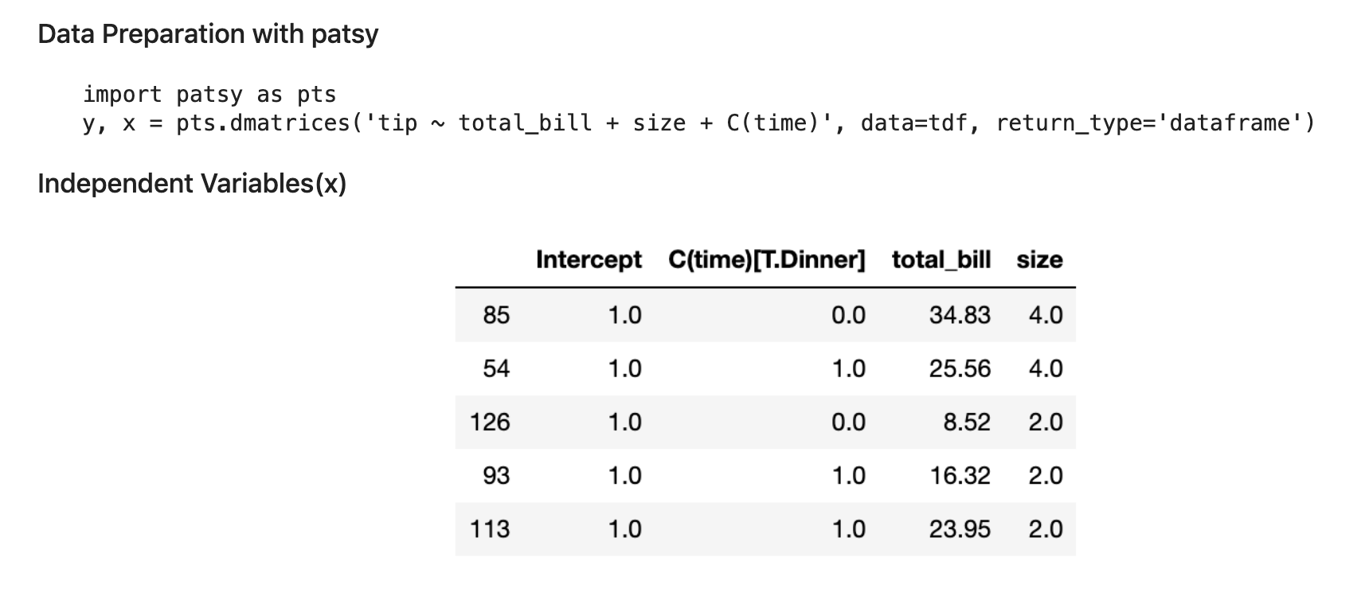
Data Preparation

Slide 7
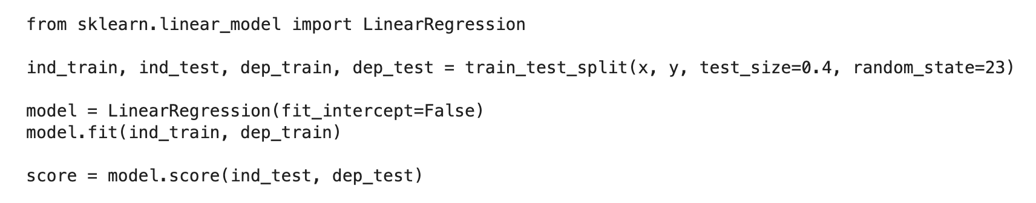
Scikit Learn LinearRegression Model

Slide 8
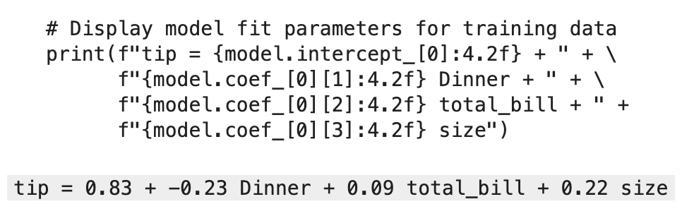
Linear Regression Formula

Slide 9
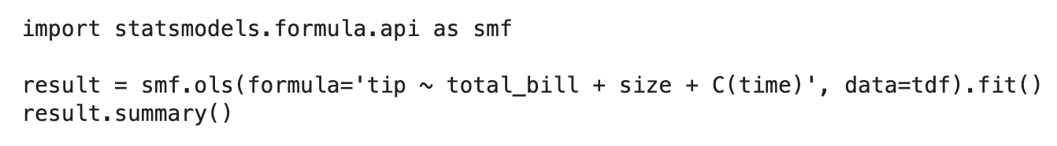
Statsmodels Linear Regression

Slide 10
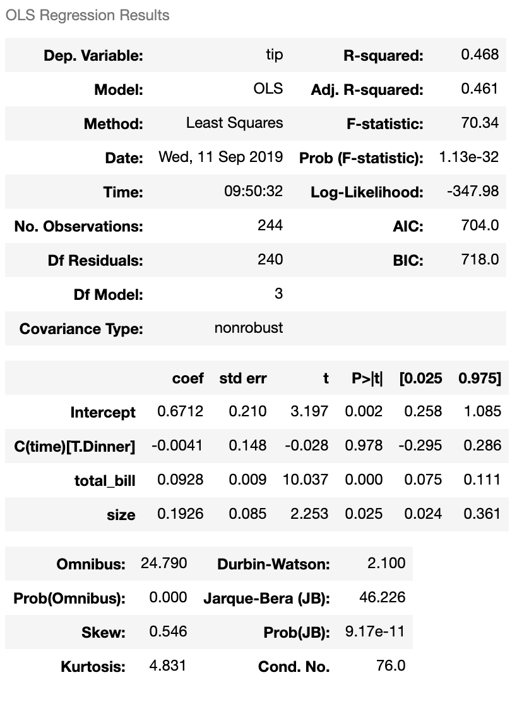
Linear Regression Result

Slide 11
Lesson 2: Logistic Regression
Supervised learning
For classification problems
Feature standardization preferred

Slide 12
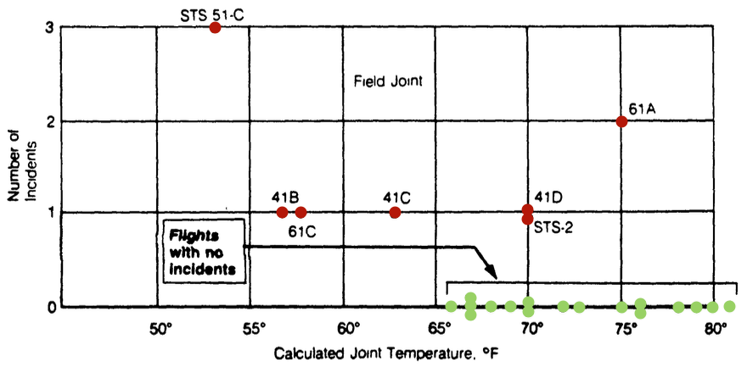
Challenger Disaster Investigation

Slide 13
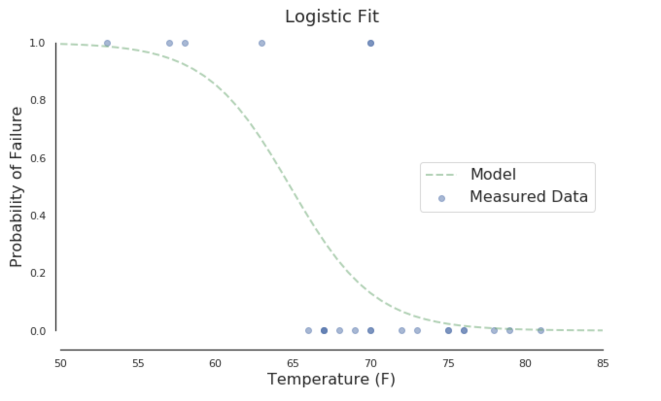
Map to Probability

Slide 14
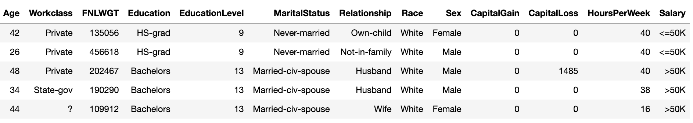
Adult Income Dataset

Slide 15
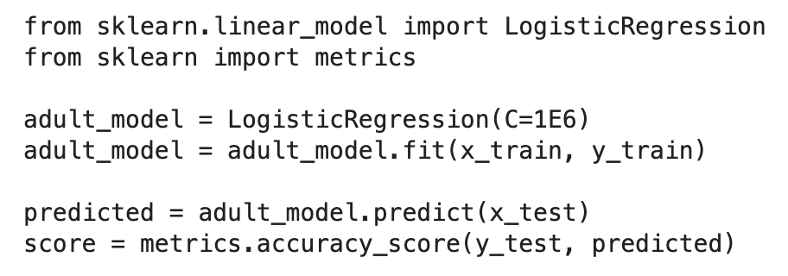
Scikit Learn LogisticRegression model

Slide 16
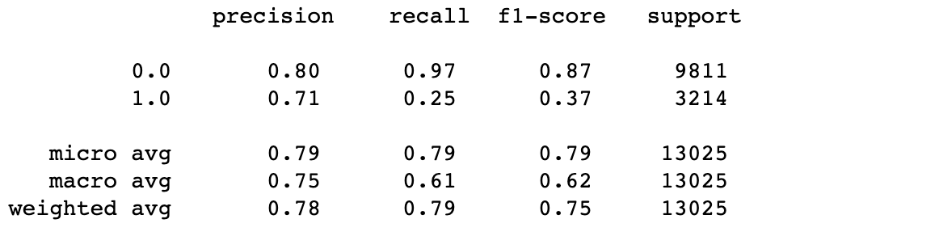
Classification Report

Slide 17
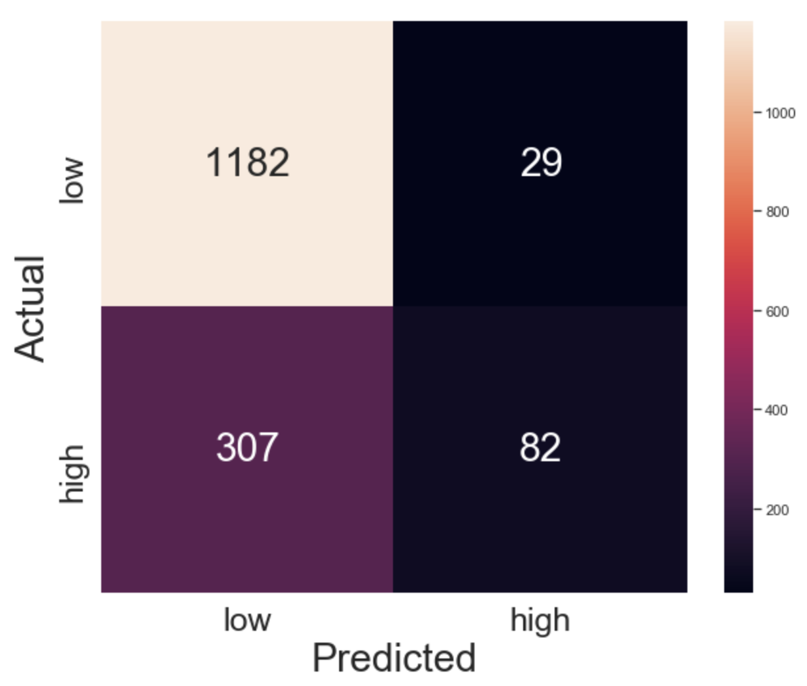
Confusion Matrix

Slide 18
Lesson 3: Decision Tree
Supervised learning
For both classification and regression problems
Can handle categorical feature(numerical)
Feature scaling is not needed

Slide 19
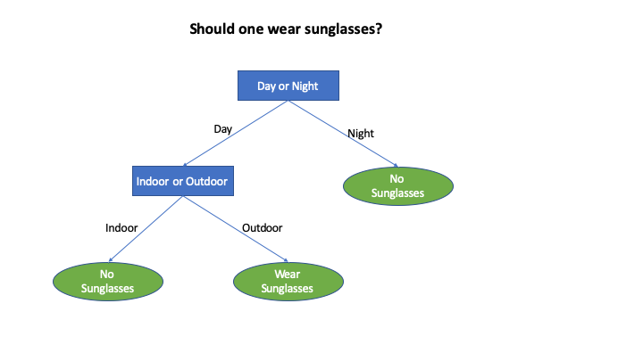
Decision Tree

Slide 20
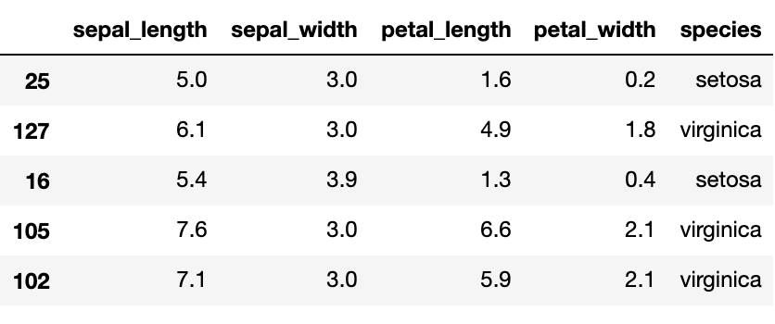
Iris Dataset

Slide 21
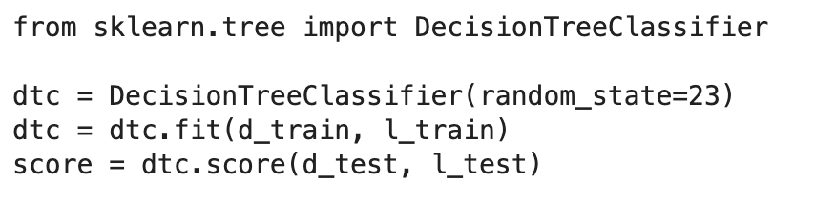
Scikit Learn Decision Tree Classifier

Slide 22
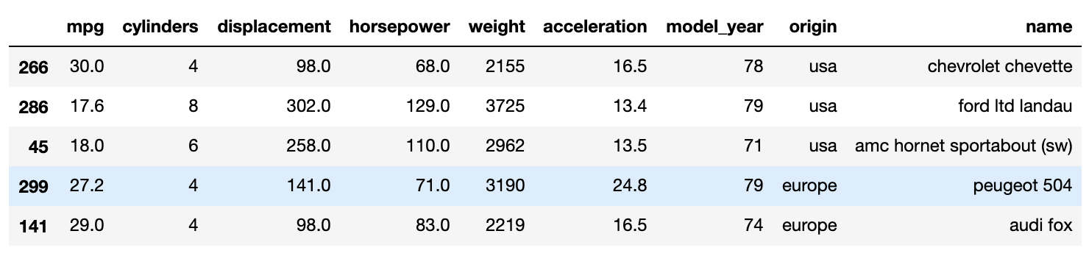
Auto MPG Dataset

Slide 23
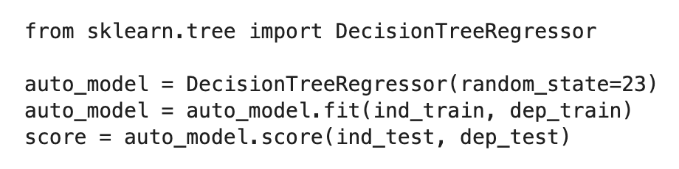
Scikit Learn Decision Tree Regressor

